Slide 1
Multithreading
Lecture 8

Slide 2
Multi threading programming
Multi-Threading is a conceptual programming paradigm where a program is divided into two or more subprograms, which can be implemented at the same time in parallel.
A thread is similar to a program that has a single flow of control.
Threads in java are subprograms of a main application program and share the same memory space, they are known as light weight threads or processes.

Slide 3
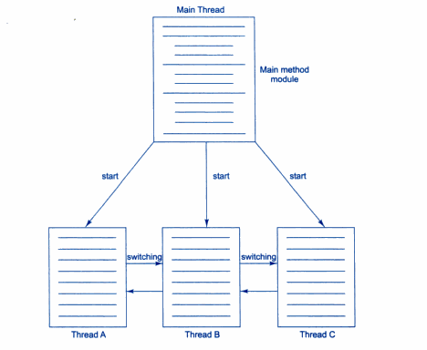
Multi threading

Slide 4
creating threads
threads are implemented in the form of objects that contain a method called run().
run() makes up the entire body of a thread and is only method in which the thread’s behaviour can be implemented.
Syntax:
public void run()
{......}
run() method should be invoked by an object of the concerned thread.
Thread can be initiated with the help of another thread method called start().

Slide 5
methods
A new thread can be created in two ways:
By creating a thread class: Define a class that extends Thread class and over ride its run() method with the required code.
By converting a class to a thread: Define a class that implements Runnable interface. The Runnable interface has only one method run() which is to be defined in the method with the code to be executed by the thread.

Slide 6
Extending the Thread class
Extend the class java.lang.Thread.
Declare a class as extending the Thread class.
implement run() method.
create a thread object and call the start() method to initiate the thread execution.
eg: MyThread athread= new MyThread();
athread.start();

Slide 7
Example
class Multi extends Thread
{
public void run()
{
System.out.println("thread is running...");
}
public static void main(String args[])
{
Multi t1=new Multi();
t1.start();
}
}

Slide 8
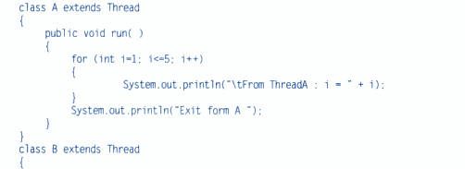
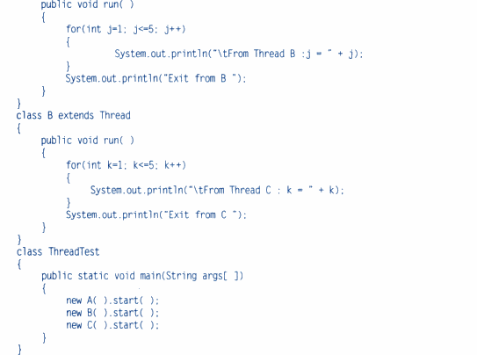

Slide 9
Stopping and blocking a thread
stop() : it causes the thread to move to a dead state. It is used when the premature death of a thread is desired.
athread.stop();
A thread can also be temporarily suspended or blocked from entering into the runnable and subsequently running state by using wither of the following thread methods:
sleep() : block for a specified time.
suspend() : block until further orders.
wait() : block until certain condition occurs.
resume() method is invoked in the case of suspend().
notify() method is called in case of wait().

Slide 10
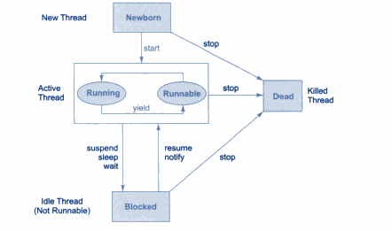
Life Cycle of a thread

Slide 11
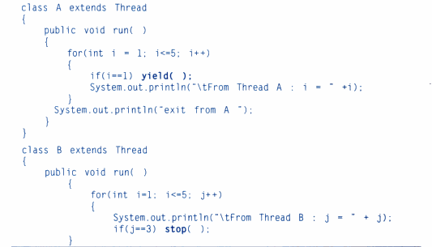

using thread method

Slide 12
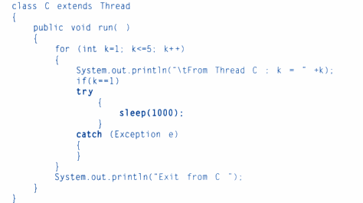

Slide 13
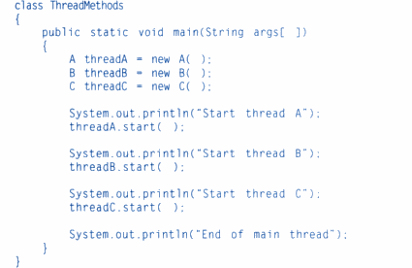

Slide 14
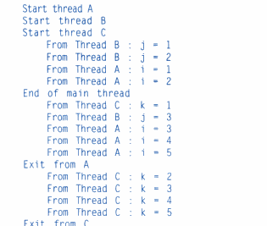
output

Slide 15
thread priority
Java permits us to set the priority of a thread using the setPriority() method:
ThreadName.setPriority(intNumber);
intNumber can have any values from 1 to 10.
MIN_PRIORITY = 1
NORM_PRIORITY = 5
MAX_PRIORITY= 10
by default it is NORM_PRIORITY.

Slide 16
class TestMultiPriority1 extends Thread
{
public void run()
{
System.out.println("running thread priority is:"+Thread.currentThread().getPriority());
}
public static void main(String args[])
{
TestMultiPriority1 m1=new TestMultiPriority1();
TestMultiPriority1 m2=new TestMultiPriority1();
m1.setPriority(Thread.MIN_PRIORITY);
m2.setPriority(Thread.MAX_PRIORITY);
m1.start();
m2.start();
}
}
OUTPUT:
running thread priority is:10
running thread priority is:1

Slide 17
SYNCHRONIZATION
When we declare a method synchronized, java creates a “Monitor” and hands it over to the thread that calls the method first time.
synchronized void update()
{.... }
It is possible to mark a block of code as synchronized :
synchronized (lock object)
{....}

Slide 18
Class Table
{
void printTable(int n)
{
for(int i=1;i<=5;i++)
{
System.out.println(n*i);
Thread.sleep(400);
}
}
}
class MyThread1 extends Thread
{
Table t;
MyThread1(Table t)
{
this.t=t;
}
public void run()
{
t.printTable(5);
}
}
class MyThread2 extends Thread
{
Table t;
MyThread2(Table t)
{
this.t=t;
}
public void run()
{
t.printTable(100);
}
}

Slide 19
class TestSynchronization1
{
public static void main(String args[])
{
Table obj = new Table();
MyThread1 t1=new MyThread1(obj);
MyThread2 t2=new MyThread2(obj);
t1.start();
t2.start();
}
}
5
100
10
200
15
300
20
400
25
500

Slide 20
IMPLEMENTING THE RUNNABLE INTERFACE
Declare the class as implementing the Runnable interface.
Implement the run() method
create a thread by defining an object that is instantiated from this runnable class as the target of the thread.
call the thread’s start method to the thread.

Slide 21
Example
class Multi3 implements Runnable
{
public void run()
{
System.out.println("thread is running...");
}
public static void main(String args[])
{
Multi3 m1=new Multi3();
Thread t1 =new Thread(m1);
t1.start();
}
}

